Slide 1
COMPUTER ORGANISATION
&
ARCHITECTURE
Instructor:Paul kisambira
Email: pkisambira@ucu.ac.ug

Slide 2
About the Course
This course is concerned with developing an understanding of the different components of a digital computer, their individual operation/function and their organization as a complete unit.
Emphasis will be placed on the major component subsystems of high performance computers: pipelining, instruction level parallelism, memory hierarchies, input/output.

Slide 3
Grading Policy
In order to receive a passing grade for this course, a student should attain greater than 35% (17.5) of the entire coursework and must attain a passing grade of greater than 35% in the final exam.
The overall grade (Coursework + Exam) however should be greater than 50% for one to pass

Slide 4
Course Outline
General overview of computer organization and architecture
Brief history of computer performance
Computer components ( Structure)
Computer function
Interconnection structures
Memory
Input /Output Module
CPU structure and function
Computer arithmetic
Control unit operation
Digital Logic

Slide 5
Reference
Lecture notes will be mainly derived from William Stallings book on Computer Organization and Architecture: Designing for Performance
David Tarnoff: Computer Organization and Design Fundamentals e-Book (Pub.www.lulu.com 2007). This is a very good free e-book.
T.C. Bartee: Computer Architecture and Logic Design (McGraw-Hill, 1991).

Slide 6
Computer Organization
Formal definition:
Refers to the operational units and the interconnections that realize the architectural specifications of the computer.
Organizational attributes include those hardware details transparent to the programmer, such as interfaces between the computer and peripheral and the memory technology used.

Slide 7
Definitions
Computer Architecture refers to attributes that have a direct impact on the logical execution of a program.
For example the logic in which numeric data and character data are represented internally in a particular operating environment.

Slide 8
Computer organization and architecture
Computer organization is the components from which computers are built
In contrast computer architecture is the science of integrating those components to achieve a level of functionality and performance
It is as if organization examines the bricks, cement, nails and other building material
While computer architecture looks at the design of the house

Slide 9
Distinction btn Arch. And Org
The distinction between architecture and organization has been an important one.
Many computer manufacturers offer a family of computer models all with the same architecture but with difference in organization. And thus differing in costs .

Slide 10
Distinction btn Arch. And Org
Different models in the family have different price and performance characteristics.
Its organization changes with the changing technology. An example is the IBM system/370 architecture.
This architecture was first introduced in 1970’s and included a number of models.
Furthermore, an architecture may survive many years, but its organization changes with changing technology

Slide 11
Structure and Function
A computer is a complex machine that most of us just know how to use.
Main focus will be the structure and function of the computer.
Computer Org & Arch - BScIT 1 @ UCU
<number>
Notes:
<number>

Slide 12
Structure and Function
Structure is defined as the way in which the components are interrelated.
ie. CPU, Main Memory, I/O, system Interconnections.
Computer Org & Arch - BScIT 1 @ UCU
<number>
Notes:
<number>

Slide 13
Function
Function is the operation of each of the individual components as part of the structure.
In general terms, there are four main functions of a computer:
Data processing
Data storage
Data movement
Control
Computer Org & Arch - BScIT 1 @ UCU
<number>
Notes:
<number>

Slide 14
Data Processing
Processing is the thinking that the computer does .
Processing - manipulation of data.
The part of a computer that interprets and executes instructions. In computing its done by the processor.
Examples of Processing
arithmetic calculations
sorting a list
modifying pictures
Computer Org & Arch - BScIT 1 @ UCU
<number>
Notes:
<number>

Slide 15
Data Storage
It is also essential that a computer store data. Even if the computer is processing data on the fly (i.e., data come in and get processed, and the results go out immediately), the computer must temporarily store at least those pieces of data that are being worked on at any given moment.
Thus, there is at least :
A Short-term data storage: Storage for Current Information
A Long term data storage: the area where data can be left on a permanent basis while it is not needed for processing
Computer Org & Arch - BScIT 1 @ UCU
<number>
Notes:
<number>

Slide 16
Data Movement
The computer must be able to move data between itself and the outside world.
The computer’s operating environment consists of devices that serve as either sources or destinations of data. When data is received from or delivered to a device that is directly connected to the computer, the process is known as input-output (I/O), and the device is referred to as a peripheral.
Computer Org & Arch - BScIT 1 @ UCU
<number>
Notes:
<number>

Slide 17
Data Movement
When data are moved over longer distances, to or from a remote device, the process is known as data communications.
Peripheral devices are hard ware equipments that might be added to a computer system to enhance its functionality.
Computer Org & Arch - BScIT 1 @ UCU
<number>
Notes:
<number>

Slide 18
Data Movement
Computer must be able to communicate with outside world
Data must be “accessible” to devices outside computer.
Two types:
Peripheral
Data communications

Slide 19
Data movement to a peripheral
Data must be passed between computer and I/O devices connected to computer
Typically to simple devices
Examples
monitors and keyboards
Computer Org & Arch - BScIT 1 @ UCU
<number>
Notes:
<number>

Slide 20
Data Movement to remote devices (data communications)
Data communications is data movement over a longer range
Typically to smart devices or other computers
Computer Org & Arch - BScIT 1 @ UCU
<number>
Notes:
<number>

Slide 21
Control
Something needs to monitor operation and maintain control of data processing, data storage, and data movement.
The control is exercised by the individuals who provide the computer with instructions . Within the computer, a control unit manages the computer resources.
Computer Org & Arch - BScIT 1 @ UCU
<number>
Notes:
<number>

Slide 22
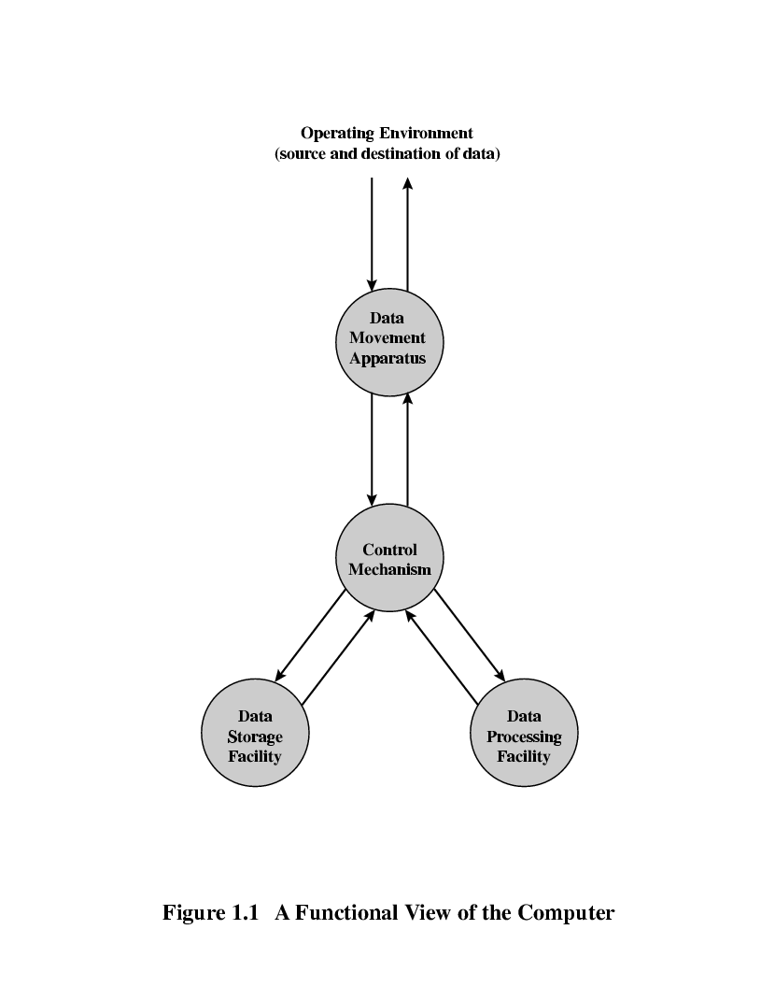
Function view
Computer Org & Arch - BScIT 1 @ UCU
<number>
Notes:
<number>

Slide 23
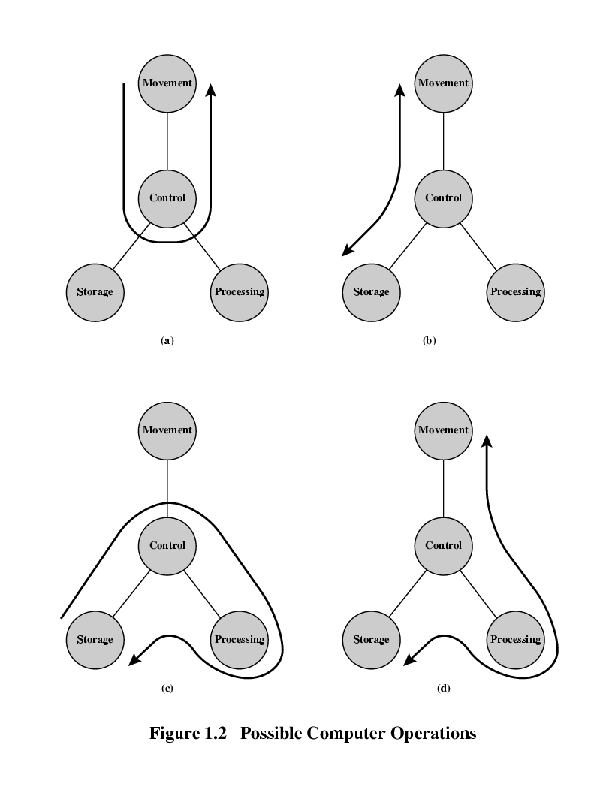
Operations of the Computer:
1.Data movement
eg . Keyboard to Screen
Computer Org & Arch - BScIT 1 @ UCU
<number>
Notes:
<number>

Slide 24
2. Storage
e.g. Internet download to disk
Computer Org & Arch - BScIT 1 @ UCU
<number>
Notes:
<number>

Slide 25
Processing from/to storage
e.g. updating bank statement
Data is either in storage or en route between storage and the external environment.
Computer Org & Arch - BScIT 1 @ UCU
<number>
Notes:
<number>

Slide 26
Processing from Storage to I/O
e.g. printing a bank statement
Computer Org & Arch - BScIT 1 @ UCU
<number>
Notes:
<number>

Slide 27
Structural components of the computer
The computer is an entity that interacts in some fashion with its external environment. In general, all of its linkages to the external environment can be classified as peripheral devices or communication lines. We will have something to say about both types of linkages
Computer Org & Arch - BScIT 1 @ UCU
<number>
Notes:
<number>

Slide 28
Structural components of the computer
CPU.
Controls the operation of the computer and performs its data processing functions. Often simply referred to as processor
Main Memory
Stores data Temporary during execution
Computer Org & Arch - BScIT 1 @ UCU
<number>
Notes:
<number>

Slide 29
Structural components of the computer
I/O
Moves data between the computer and its external environment.
Between comp & External environment (peripherals)
If distances are long – Communication
System interconnections
Provide communication between CPU, Main Memory & I/O.

Slide 30
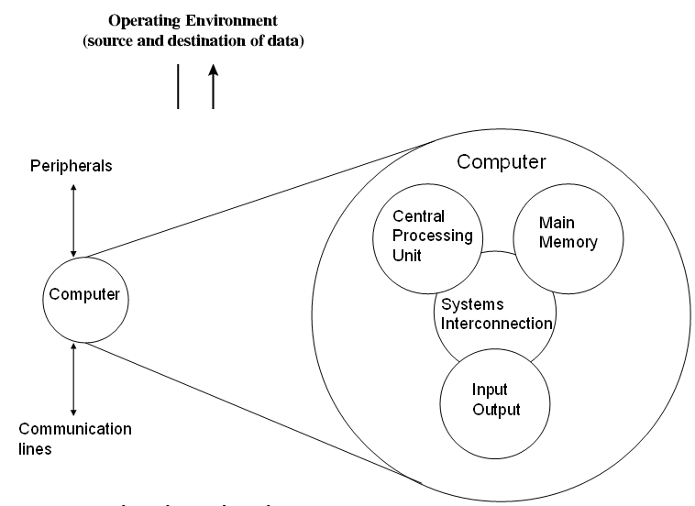
Structure. Top Level Structure
Computer Org & Arch - BScIT 1 @ UCU
<number>
Notes:
<number>

Slide 31
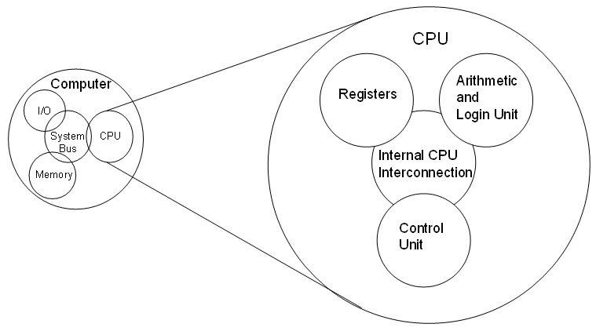
Structure . The CPU
Computer Org & Arch - BScIT 1 @ UCU
<number>
Notes:
<number>

Slide 32
Architecture
interface between hardware and software
abstract model and is programmer's view in terms of instructions,addressing modes and registers
describes what computer does
while designing computer system architecture is considered first
it deals with high level design issues
eg : is there a multiplication instruction??
Organisation
deals with components of connection in a system
expresses the realization of architecture
describes how computer does a task
organization is done on the basis of architecture
deals with low level design issues
eg : is there a multiplication unit or is it done by repeated addition??

